Slide 1

CREDIT CARD FRAUD DETECTION USING MACHINE LEARNING
Notes:
In this presentation, the focus is on detecting credit card fraud with the help of machine learning. Due to the blistering development of online payments, fraud has become a significant issue in terms of money. This paper analyses various machine learning algorithms to identify fraudulent transactions. The project is based on real-world datasets and aims at improving detection accuracy and solving such problems as the imbalance between classes and the evaluation of models.

Slide 2

INTRODUCTION
Expansion of online payment systems.
Increase in credit card fraud.
Weakness of conventional approaches.
Need for intelligent solutions
Notes:
Credit card fraud has increased with the increase in online transactions. The conventional fraud detection systems are based on predetermined rules that do not fit the changing trends of fraud. These systems tend to give a lot of false positives and are not flexible. Thus, fraud detection needs to be done more efficiently and precisely in real-time financial settings with intelligent machine learning solutions.

Slide 3
AIM & OBJECTIVES
Create fraud detection models.
Compare multiple ML algorithms
Address class imbalance issue.
Improve detection accuracy
Notes:
The primary aim of this research is to come up with machine learning models to identify fraudulent transactions. The project is a comparison between Logistic Regression, Random Forest, and XGBoost algorithms. It is also concerned with dealing with the imbalance in classes, which is a significant problem with fraud datasets. The objective is to enhance the quality of detection whilst achieving a balance in precision and recall.

Slide 4
RESEARCH QUESTIONS
Effectiveness of ML in fraud detection
Effects of transaction characteristics.
Best performing algorithm
Suitable evaluation metrics
Notes:
The research questions that are answered in this study include the effectiveness of machine learning models in fraud detection. It also examines what features of transactions make the most contribution towards predictions. The other emphasis is on determining the most successful algorithm amongst the models of choice. Also, the paper investigates the most appropriate evaluation metrics when dealing with imbalanced data.

Slide 5
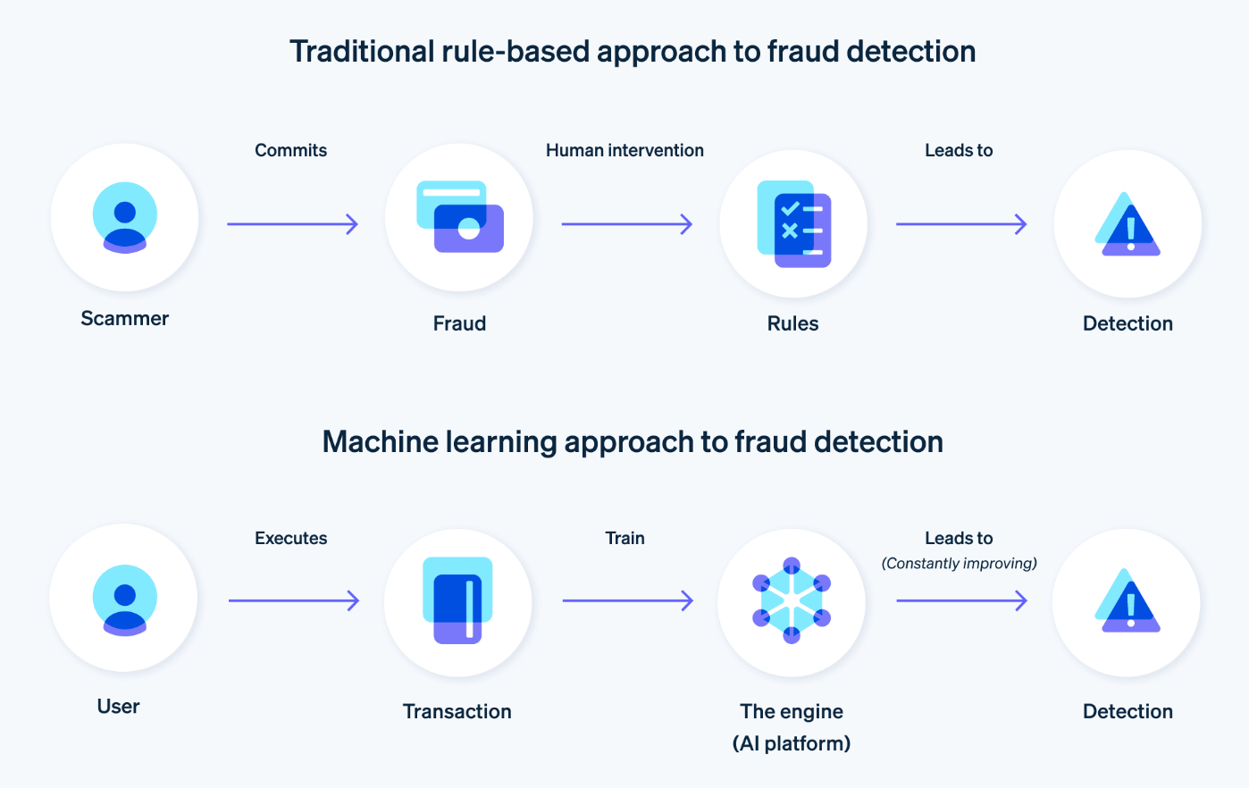
LITERATURE REVIEW
ML vs traditional approaches.
Significance of ensemble models.
Class imbalance challenge
Evaluation beyond accuracy
Notes:
This is indicated in the literature review as the shift to machine learning systems as opposed to conventional rule-based systems. Random Forest and XGBoost ensemble models have performed better. One of the challenges found to be a big challenge is the imbalance of classes, of which fraud cases are very scarce. The review also highlights the use of such measures as precision, recall, and PR-AUC rather than focusing solely on accuracy.

Slide 6
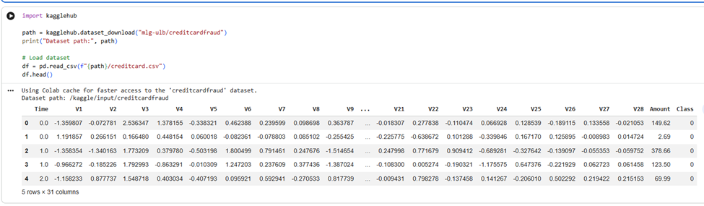
METHODOLOGY
Quantitative experimental design
Use of Kaggle dataset
Data preprocessing techniques
Model training and testing.
Notes:
In the present research, the experimental design is quantitative and is based on a real-life dataset obtained at Kaggle. Preprocessing of data involves scaling and cleaning of features. Stratified sampling is used to divide the dataset into training and testing sets. The performance metrics used to train and evaluate machine learning models are designed to guarantee reliable and unbiased outcomes.

Slide 7
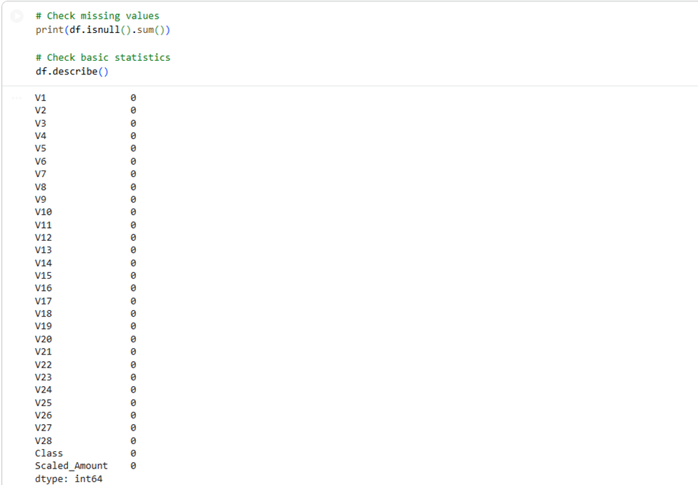
DATA PREPROCESSING
Feature scaling applied
No missing data.
Train-test split (80:20)
Data transformation performed
Notes:
Preprocessing of data plays a very crucial role in this project. The feature scaling is used to bring values to the normal level to enhance the performance of the model. There are no missing values in the dataset, making preprocessing easier. A train-test split of 80:20 is applied with stratification to keep the classes balanced. The transformation of data makes sure that features are valuable when training a model.

Slide 8
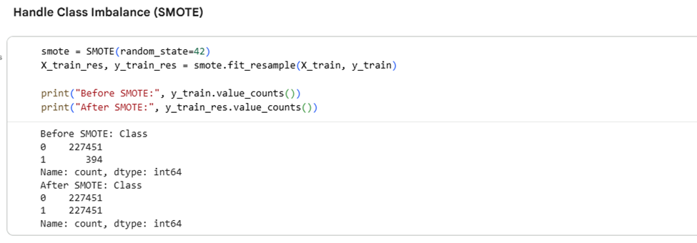
HANDLING CLASS IMBALANCE
There are very few fraud cases.
SMOTE technique applied
Balanced training dataset
Improved model learning
Notes:
The imbalance of classes is a crucial problem in fraud detection, as fraud is very infrequent. To counter this, the SMOTE algorithm is utilised to come up with artificial samples of the minority group. This equalises the dataset and aids models in learning fraud patterns more effectively. Caution is taken, though, to apply SMOTE only to training data to prevent leakage of data.

Slide 9
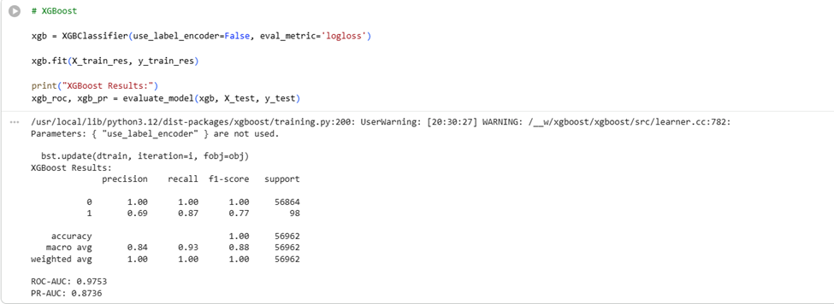
MODELS USED
Logistic Regression (baseline)
Random Forest (ensemble model)
XGBoost (boosting model)
Comparative analysis
Notes:
In this study, three machine learning models are used. Logistic Regression is used as a baseline model due to its simplicity. An ensemble model, Random Forest, is enhanced by decision trees, making it better. XGBoost is a Boosting algorithm and is very accurate in its predictions. Such models are compared to find the most effective one in detecting fraud.

Slide 10
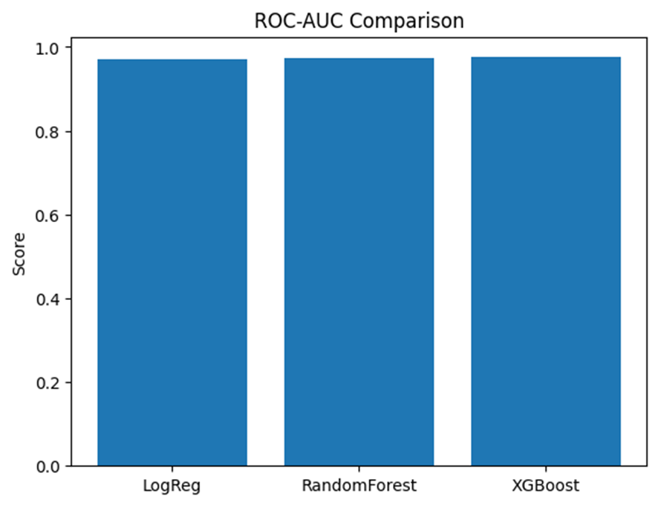
RESULTS & FINDINGS
Logistic Regression: low precision, high recall.
Random Forest: average performance.
XGBoost: most suitable model.
PR-AUC is the most reliable measure.
Notes:
The findings indicate that Logistic Regression is highly recalled and low in precision, thus resulting in a high number of false positives. Random Forest offers both precision and recall results. XGBoost has the most optimal results with good predictive power. Another important conclusion of the study is that PR-AUC has proven to be a more accurate measure of model evaluation on imbalanced datasets than accuracy.

Slide 11
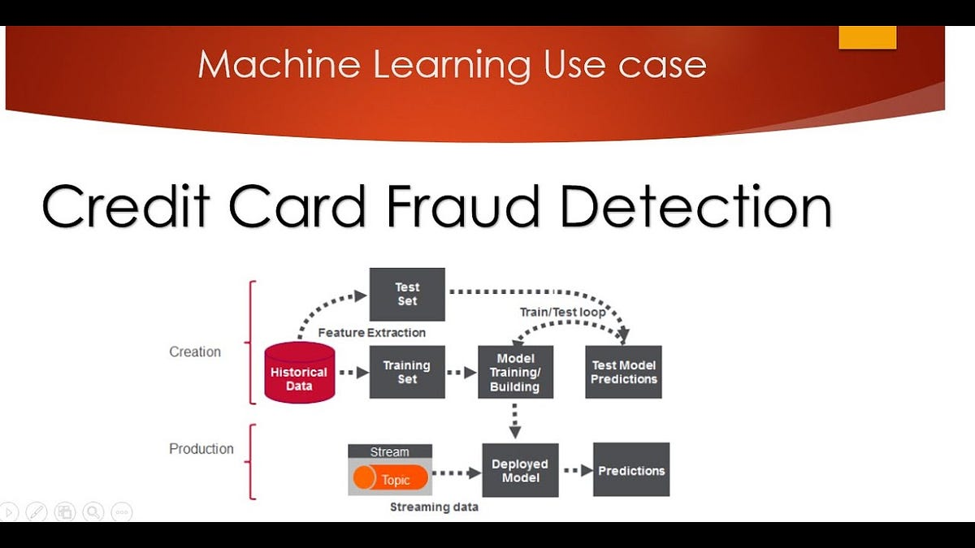
CONCLUSION
ML enhances the detection of fraud.
Handling of class imbalance is important.
XGBoost performs best
Future improvement possibilities.
Notes:
To sum up, machine learning is a valuable tool in the detection of credit card fraud. Class imbalance is a critical issue to deal with to make reliable predictions. XGBoost is the most suitable model of all models tested. Nevertheless, it can be further enhanced, including the implementation of deep learning models and real-time systems. Other areas that can be discussed in future studies are to make the models more interpretable.

Slide 12
REFERENCES
Btoush, E.A.L.M., Zhou, X., Gururajan, R., Chan, K.C., Genrich, R. and Sankaran, P., 2023. A systematic review of literature on credit card cyber fraud detection using machine and deep learning. PeerJ Computer Science, 9, p.e1278.
Chhabra, R., Goswami, S. and Ranjan, R.K., 2024. A voting ensemble machine learning based credit card fraud detection using highly imbalance data. Multimedia Tools and Applications, 83(18), pp.54729-54753.
Dunleavy, P. and Margetts, H., 2025. Data science, artificial intelligence and the third wave of digital era governance. Public Policy and Administration, 40(2), pp.185-214.
Notes:
Btoush, E.A.L.M., Zhou, X., Gururajan, R., Chan, K.C., Genrich, R. and Sankaran, P., 2023. A systematic review of literature on credit card cyber fraud detection using machine and deep learning. PeerJ Computer Science, 9, p.e1278.
Chhabra, R., Goswami, S. and Ranjan, R.K., 2024. A voting ensemble machine learning based credit card fraud detection using highly imbalance data. Multimedia Tools and Applications, 83(18), pp.54729-54753.
Dunleavy, P. and Margetts, H., 2025. Data science, artificial intelligence and the third wave of digital era governance. Public Policy and Administration, 40(2), pp.185-214.
Faraji, Z., 2022. A Review of Machine Learning Applications for Credit Card Fraud Detection with A Case study. SEISENSE Journal of Management, 5(1).

Slide 13
THANK YOU !!

